Slide 1
Introduction to Web Development
CS/IT 490 WD
Fall 2013

Slide 2
Breakdown
What goes into web development?
What are all these different languages?!
What we will learn in this class
Why Open Source?
Goals

Slide 3
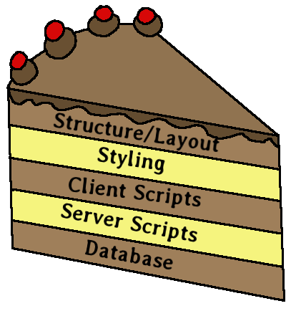
What goes into web development?
There are many layers when it comes to web development (and, with software development, too!)
It is good practice to separate out things like the page content from the styling, and those things from the behind-the-scenes logic.

Slide 4
What goes into web development?
User Experience (UX) is important to make sure users can easily navigate the webpage and things look nice. This includes HTML & CSS.
Data calculated, procured, or otherwise obtained by the server-side scripts need to be plugged into the HTML pages.
Server-side scripts will be passed in data and return data – a web request that returns a database query?
Data may need to be stored and retrieved from a database.

Slide 5
What are all these different languages?!
XHTML: eXtensible Hypertext Markup Language
  The page structure
  Not a programming language. Don't call it a programming language. It's markup.
  Early versions of HTML had tags for styling, such as <color=”#FF0000”> or <center>
  These tags are deprecated, and styling should be handled by CSS now.
  XHTML is for creating the elements of a webpage.

Slide 6
What are all these different languages?!
HTML vs. XHTML:
  XHTML is a derivative of HTML
  It is based on XML
    Makes HTML more consistent, obvious if it is wrong (uneven tag opening/closing, etc.)
  It is very close to HTML 4.01
  Mandatory tags added
  Formatting style required

Slide 7
What are all these different languages?!
XHTML Mandatory tags:
  DOCTYPE
  <html>, <head>, <title>, <body>
XHTML Formatting:
  All elements & attributes are lower-case
  All attribute values enclosed within quotes
  All elements must be closed
  <body> … </body>
Source: http://www.w3schools.com/html/html_xhtml.asp

Slide 8
What we will learn in this class
CSS – Cascading Style Sheets
  Also use CSS for specifying positions, alignments, dimensions, etc. of elements on a webpage.
  CSS can be frustrating at first but it's a great tool.
  You CAN inline CSS into your HTML code -- but don't.

Slide 9
What we will learn in this class
PHP – PHP: Hypertext Preprocessor
  Used for server-side scripting
  Similar to C++ syntax
  Many PHP libraries out there
  Can add two numbers together, or query a database, or interact with a third-party API (Application Programming Interface)

Slide 10
What we will learn in this class
PHP – PHP: Hypertext Preprocessor
  Very very easy to write messy code
  Web frameworks exist to lessen writing of “boilerplate” code.
    CakePHP
    Symfony
    CodeIgniter

Slide 11
What we will learn in this class
PHP – PHP: Hypertext Preprocessor
  Many “ready-to-go” web solutions also are written in PHP
    Wordpress
    Drupal
    Joomla
    PhpBB

Slide 12
What we will learn in this class
MySQL
  RDBMS (Relational Database Management System)
  Store data in a database with tables
  Tables can have relationships to each other (therefore, Relational Database)
  We will focus on very simple database schemas; this is not a formal RDBMS Design class.

Slide 13
What we will learn in this class
JavaScript, Jquery, AJAX
  JavaScript is a client-side scripting language
  Jquery is a library to extend JavaScript and helps you write easy, unobtrusive, clean code
  AJAX allows you to send/receive data to a server-side call from the client-side (obvious symptom: No refreshing!)

Slide 14
What we will learn in this class
JavaScript, Jquery, AJAX
  Client-side JavaScript can be used to enhance a webpage.
    Thumbnails that blow up when clicked
    Animated drop-down boxes
    Pop-up modal windows
  It is good practice to make sure your webpage can be navigated without JavaScript enabled, however.

Slide 15
Why Open Source?
It's (usually) free: No cost
You can view the source code!
  You could edit it to fit your needs, if desired
Lots of people use it because it's Open Source
  More help, documentation, plugins, etc.
  Plugins for proprietary systems may end up costing more

Slide 16
Why Open Source?
It's (usually) free: No cost
You can view the source code!
  You could edit it to fit your needs, if desired
Lots of people use it because it's Open Source
  More help, documentation, plugins, etc.
  Plugins for proprietary systems may end up costing more

Slide 17
Why Open Source?
http://www.youtube.com/watch?v=7NShpY_oSs4
Everybody can peer-review Open Source code. Anyone can contribute to Open Source code. Anyone can fix Open Source code.
Proprietary solutions can cost $$$
  Sometimes forbidding for small companies & individuals

Slide 18
Goals
Be able to build a competent & functional dynamic webpages with Open Source technology like PHP and MySQL.
Be able to design and build websites with good UX, with HTML, CSS, and JavaScript.
Be able to design & implement basic database schemas.
Set up a web server with Apache, and/or be able to set up websites on a hosted service.

Slide 19
Goals
Any goals you want to add?

Slide 20
References
Introduction to XHTML, w3schools, http://www.w3schools.com/html/html_xhtml.asp

